Slide 1
Building a Simple Agent: Programmatic Use of AI
Week 6 CSSE290 Prof Software Development with AI
Matt Boutell

Slide 2



A chat interface is great, but …
LLM
It needs a person to copy-paste!
This Photo by Unknown Author is licensed under CC BY-NC-ND

Slide 3



… what if it is part of an automatic workflow?
LLM
server
Web page
DB
It’s the same problem Cursor solves: avoid copy-paste into a chat interface
images: Flaticon.com

Slide 4
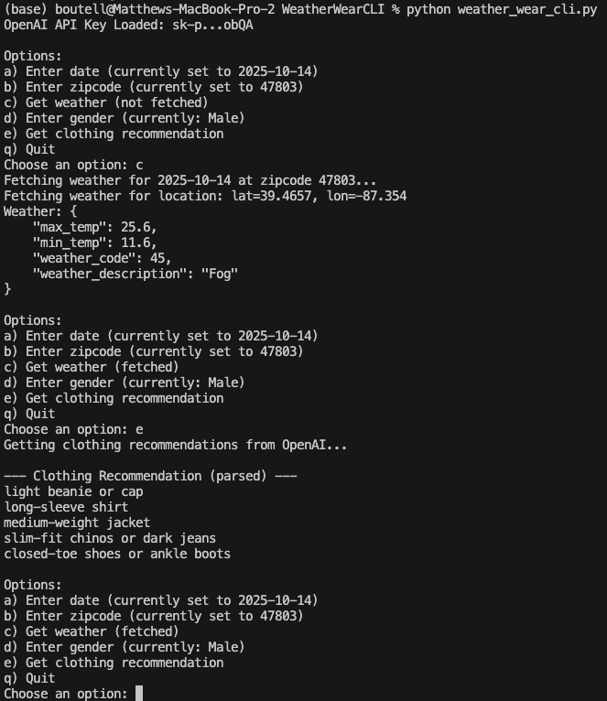
Sample app: Weather to Wear
Ask GPT for clothing recommendations, given the person’s gender, plus date, location, and forecast for that day.
“semi-automatic”
Shoutout to Kiana Caston for building this Android app many years ago in CSSE483!
And to Google Gemini CLI for speeding this up

Slide 5
Companies provide APIs for this use case
Open AI
Gemini
Groq
others
Today: practices for using the API!
Best practices for using the API?

Slide 6
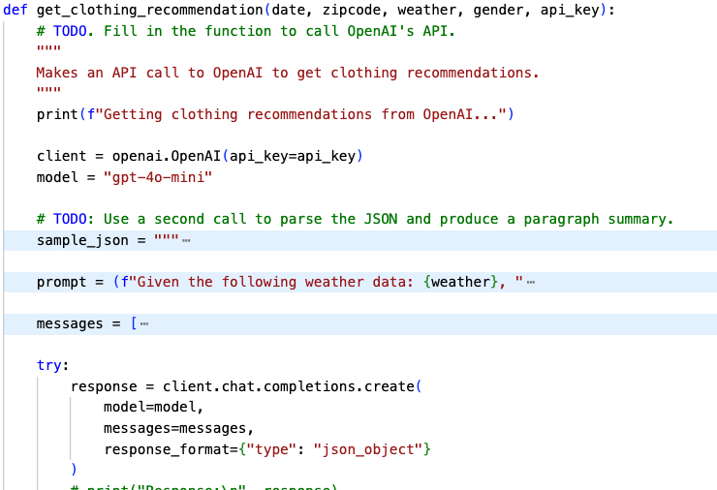
Where is the AI usage in this app?
We are using the Completions API.
Needs a model, messages, and response format.

Slide 7
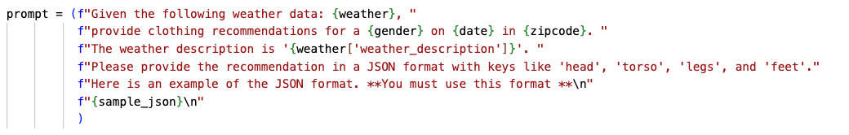
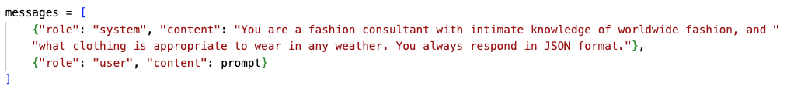
What do we need to provide?
A user prompt, usually a very detailed one. Include:
The input
Instructions on how to use the input
How to format the response (json works well!)
You can specify a system prompt too!

Slide 8
It will return a response…
ChatCompletion(id='chatcmpl-CQcw70DG6A7aEnbrYeDUHZX3X18oi', choices=[Choice(finish_reason='stop', index=0, logprobs=None, message=ChatCompletionMessage(content='{\n "recommendation": {\n "head": {\n "item": "light beanie or cap",\n "material": "cotton or wool",\n "description": "To keep warm in cool, foggy weather."\n },\n "torso": {\n "item": "long-sleeve shirt",\n "material": "cotton or light flannel",\n "description": "Layered under a light jacket for warmth."\n },\n "additional_layer": {\n "item": "lightweight, water-resistant jacket",\n "material": "polyester or nylon",\n "description": "To protect against fog and possible moisture."\n },\n "legs": {\n "item": "chino pants or dark jeans",\n "material": "cotton or denim",\n "description": "Suitable for cool temperatures and comfortable for daily wear."\n },\n "feet": {\n "item": "comfortable, waterproof shoes or boots",\n "material": "leather or synthetic",\n "description": "Versatile footwear that keeps your feet dry in humid conditions."\n }\n }\n}', refusal=None, role='assistant', annotations=[], audio=None, function_call=None, tool_calls=None))], created=1760462235, model='gpt-4o-mini-2024-07-18', object='chat.completion', service_tier='default', system_fingerprint='fp_560af6e559', usage=CompletionUsage(completion_tokens=231, prompt_tokens=373, total_tokens=604, completion_tokens_details=CompletionTokensDetails(accepted_prediction_tokens=0, audio_tokens=0, reasoning_tokens=0, rejected_prediction_tokens=0), prompt_tokens_details=PromptTokensDetails(audio_tokens=0, cached_tokens=0)))
Thus: recommendation = json.loads(response.choices[0].message.content)

Slide 9
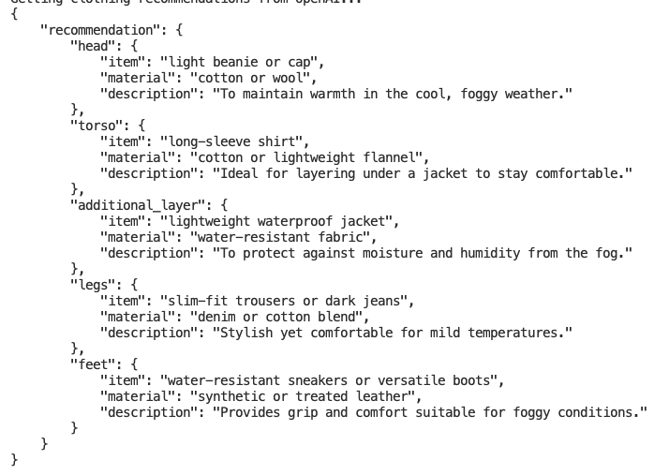
You may need to parse the response further.
JSON is usually easy to parse…
…as long as the LLM returns it in that format.

Slide 10
Best-practice: Don’t push your key to GitHub.
If you do, we’ll charge you for any misuse of it by the internet trolls.
Seriously. It should only cost you like $0.10-.20 to test out this app.

Slide 11
Instead, put your key in a git-ignored .env file
We set this up for you in code:
You just stick the key here in a .env text file that you create:
OPENAI_API_KEY=sk-pr...obQA

Slide 12
Each API call you make is “fresh”.
The LLM doesn’t store your history of calls.
If you want history, track it yourself.

Slide 13
Each API call you make is “fresh”.
The LLM doesn’t store your history of calls.
If you want history, track it yourself.

Slide 14
One size fits all? NOT!
A prompt that you tune to work one well on OpenAI GPT-4o-mini won’t necessarily be amazing on another LLM. How will you know how well it works?

Slide 15
Demo of the completed app
How well does it work?

Slide 16
Your job…
Write the prompt. Figure out if you need to tweak it for better results.
Make the call.
Parse the response.

Slide 17
Extensions: Handling Big Files
What if the .csv file that you need to ask the LLM questions about is 30,000 lines long?
Why is this a problem?
What should we do?

Slide 18
Extensions: Parsing the Response
What if it is painful to parse the LLM’s response?
Any ideas for what to do?
Notes:
Past student answers:
Give it more examples.
If the response is free-form or complicated, you can make a second call to the LLM, asking it to parse the response.
Catch the exception and give a default, or add the exception to the message and ask the LLM to retry.

Slide 19
OpenAI API
https://platform.openai.com/docs/api-reference/chat/create
Of course they are pushing the latest version of the model. You won’t need that here.
Other interesting things in the ChatCompletions and Responses APIs
Websearch: a responses tool.
Image: use as input to the call.

Slide 20
API
Websearch: a responses tool.
Image: use as input to the call.
Back to the API for hooks.

